Slide 1
Future loan eligibilty prediction analytics using ibm cognos
Presented by:
Team no:cse-004
18UK1A0594-Surya teja
18UK1A0591-k.Navya
18UK1A05c0-v.Vamshi
18UK1A0595-p.Sudeep reddy

Slide 2
Outline :
INTRODUCTION
OBJECTIVE
IBM CLOUD
IBM COGNOS ANALYTICS
WORKING WITH THE DATASET
DATA VISUALIZATION CHARTS
CREATING DASHBOARD
EXPORT THE ANALYSIS
CONCLUSION

Slide 3
introduction
Dream Housing Finance company deals in all home loans. They have a presence across all urban, semi-urban, and rural areas.
Customer – First applies for a Home Loan, after that company validates the eligibility by building own model to predict the eligibility.
Company wants to automate the Loan Eligibility Process in a real time scenario with the detail provided while applying application for home loan.
We will try to build a model using data from loan applications.
As per this project we will analyzing some important visualizations creating a dashboard and by going through these we will get most of the insights of future loan eligibility prediction analytics.

Slide 4
objective
Loan Prediction is very helpful for employee of banks as well as for the applicant also.
The aim of this Project is to provide quick, immediate and easy way to choose the deserving applicants. ..
A time limit can be set for the applicant to check whether his/her loan can be sanctioned or not.
The objective of the problem is to pick out which customer will be able to pay the debt and which customer is likely will not be able to pay the debts. We have used the ibm cognos to solve this.

Slide 5
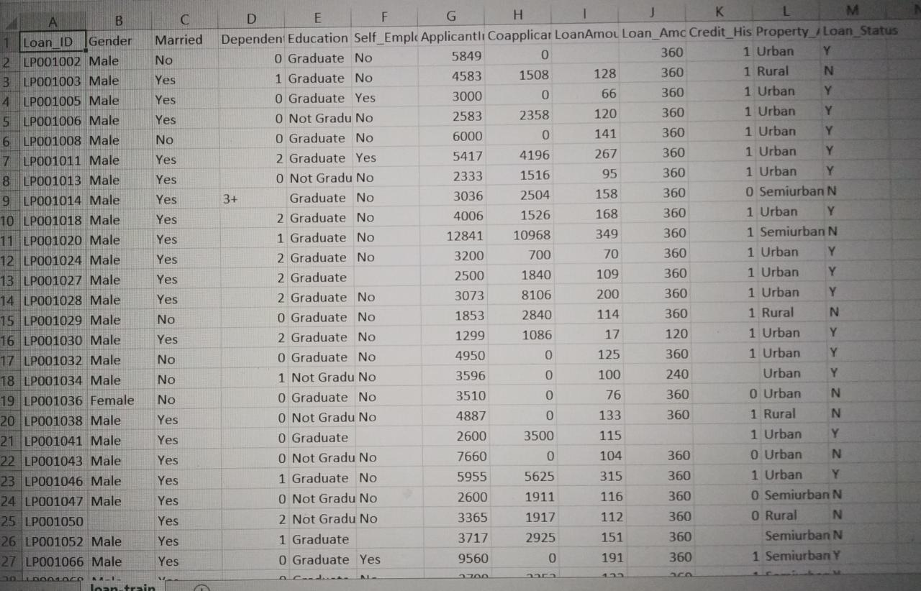
Data :
Loan_ID | Gender | Married | Dependents | Education | Self_Employed | ApplicantIncome | CoapplicantIncome | LoanAmount | Loan_Amount_Term | Credit_History | Property_Area | Loan_Status
Loan_ID | Male | No | 0 | Graduate | No | 5849 | 0 |  | 360 | 1 | Urban | Y
Loan_ID | Male | Yes | 1 | Graduate | No | 4583 | 1508 | 128 | 360 | 1 | Rural | N
Loan_ID | Male | Yes | 0 | Graduate | Yes | 3000 | 0 | 66 | 360 | 1 | Urban | Y
Loan_ID | Male | Yes | 0 | Not Graduate | No | 2583 | 2358 | 120 | 360 | 1 | Urban | Y
Loan_ID | Male | No | 0 | Graduate | No | 6000 | 0 | 141 | 360 | 1 | Urban | Y
Loan_ID | Male | Yes | 2 | Graduate | Yes | 5417 | 4196 | 267 | 360 | 1 | Urban | Y
Loan_ID | Male | Yes | 0 | Not Graduate | No | 2333 | 1516 | 95 | 360 | 1 | Urban | Y
Loan_ID | Male | Yes | 3+ | Graduate | No | 3036 | 2504 | 158 | 360 | 0 | Semiurban | N
Loan_ID | Male | Yes | 2 | Graduate | No | 4006 | 1526 | 168 | 360 | 1 | Urban | Y
Loan_ID | Male | Yes | 1 | Graduate | No | 12841 | 10968 | 349 | 360 | 1 | Semiurban | N
Loan_ID | Male | Yes | 2 | Graduate | No | 3200 | 700 | 70 | 360 | 1 | Urban | Y
Loan_ID | Male | Yes | 2 | Graduate |  | 2500 | 1840 | 109 | 360 | 1 | Urban | Y
Loan_ID | Male | Yes | 2 | Graduate | No | 3073 | 8106 | 200 | 360 | 1 | Urban | Y
Loan_ID | Male | No | 0 | Graduate | No | 1853 | 2840 | 114 | 360 | 1 | Rural | N
Loan_ID | Male | Yes | 2 | Graduate | No | 1299 | 1086 | 17 | 120 | 1 | Urban | Y
Loan_ID | Male | No | 0 | Graduate | No | 4950 | 0 | 125 | 360 | 1 | Urban | Y
Loan_ID | Male | No | 1 | Not Graduate | No | 3596 | 0 | 100 | 240 |  | Urban | Y
Loan_ID | Female | No | 0 | Graduate | No | 3510 | 0 | 76 | 360 | 0 | Urban | N
Loan_ID | Male | Yes | 0 | Not Graduate | No | 4887 | 0 | 133 | 360 | 1 | Rural | N
Loan_ID | Male | Yes | 0 | Graduate |  | 2600 | 3500 | 115 |  | 1 | Urban | Y
Loan_ID | Male | Yes | 0 | Not Graduate | No | 7660 | 0 | 104 | 360 | 0 | Urban | N
Loan_ID | Male | Yes | 1 | Graduate | No | 5955 | 5625 | 315 | 360 | 1 | Urban | Y
Loan_ID | Male | Yes | 0 | Not Graduate | No | 2600 | 1911 | 116 | 360 | 0 | Semiurban | N
Loan_ID |  | Yes | 2 | Not Graduate | No | 3365 | 1917 | 112 | 360 | 0 | Rural | N
Loan_ID | Male | Yes | 1 | Graduate |  | 3717 | 2925 | 151 | 360 |  | Semiurban | N
Loan_ID | Male | Yes | 0 | Graduate | Yes | 9560 | 0 | 191 | 360 | 1 | Semiurban | Y
Loan_ID | Male | Yes | 0 | Graduate | No | 2799 | 2253 | 122 | 360 | 1 | Semiurban | Y
Loan_ID | Male | Yes | 2 | Not Graduate | No | 4226 | 1040 | 110 | 360 | 1 | Urban | Y
Loan_ID | Male | No | 0 | Not Graduate | No | 1442 | 0 | 35 | 360 | 1 | Urban | N
Loan_ID | Female | No | 2 | Graduate |  | 3750 | 2083 | 120 | 360 | 1 | Semiurban | Y
Loan_ID | Male | Yes | 1 | Graduate |  | 4166 | 3369 | 201 | 360 |  | Urban | N
Loan_ID | Male | No | 0 | Graduate | No | 3167 | 0 | 74 | 360 | 1 | Urban | N
Loan_ID | Male | No | 1 | Graduate | Yes | 4692 | 0 | 106 | 360 | 1 | Rural | N
Loan_ID | Male | Yes | 0 | Graduate | No | 3500 | 1667 | 114 | 360 | 1 | Semiurban | Y
Loan_ID | Male | No | 3+ | Graduate | No | 12500 | 3000 | 320 | 360 | 1 | Rural | N
Loan_ID | Male | Yes | 0 | Graduate | No | 2275 | 2067 |  | 360 | 1 | Urban | Y
Loan_ID | Male | Yes | 0 | Graduate | No | 1828 | 1330 | 100 |  | 0 | Urban | N
Loan_ID | Female | Yes | 0 | Graduate | No | 3667 | 1459 | 144 | 360 | 1 | Semiurban | Y
Loan_ID | Male | No | 0 | Graduate | No | 4166 | 7210 | 184 | 360 | 1 | Urban | Y
Loan_ID | Male | No | 0 | Not Graduate | No | 3748 | 1668 | 110 | 360 | 1 | Semiurban | Y
Loan_ID | Male | No | 0 | Graduate | No | 3600 | 0 | 80 | 360 | 1 | Urban | N
Loan_ID | Male | No | 0 | Graduate | No | 1800 | 1213 | 47 | 360 | 1 | Urban | Y
Loan_ID | Male | Yes | 0 | Graduate | No | 2400 | 0 | 75 | 360 |  | Urban | Y
Loan_ID | Male | Yes | 0 | Graduate | No | 3941 | 2336 | 134 | 360 | 1 | Semiurban | Y
Loan_ID | Male | Yes | 0 | Not Graduate | Yes | 4695 | 0 | 96 |  | 1 | Urban | Y
Loan_ID | Female | No | 0 | Graduate | No | 3410 | 0 | 88 |  | 1 | Urban | Y
Loan_ID | Male | Yes | 1 | Graduate | No | 5649 | 0 | 44 | 360 | 1 | Urban | Y
Loan_ID | Male | Yes | 0 | Graduate | No | 5821 | 0 | 144 | 360 | 1 | Urban | Y
Loan_ID | Female | Yes | 0 | Graduate | No | 2645 | 3440 | 120 | 360 | 0 | Urban | N
Loan_ID | Female | No | 0 | Graduate | No | 4000 | 2275 | 144 | 360 | 1 | Semiurban | Y
Loan_ID | Female | Yes | 0 | Not Graduate | No | 1928 | 1644 | 100 | 360 | 1 | Semiurban | Y
Loan_ID | Female | No | 0 | Graduate | No | 3086 | 0 | 120 | 360 | 1 | Semiurban | Y
Loan_ID | Female | No | 0 | Graduate | No | 4230 | 0 | 112 | 360 | 1 | Semiurban | N
Loan_ID | Male | Yes | 2 | Graduate | No | 4616 | 0 | 134 | 360 | 1 | Urban | N
Loan_ID | Female | Yes | 1 | Graduate | Yes | 11500 | 0 | 286 | 360 | 0 | Urban | N
Loan_ID | Male | Yes | 2 | Graduate | No | 2708 | 1167 | 97 | 360 | 1 | Semiurban | Y
Loan_ID | Male | Yes | 0 | Graduate | No | 2132 | 1591 | 96 | 360 | 1 | Semiurban | Y
Loan_ID | Male | Yes | 0 | Graduate | No | 3366 | 2200 | 135 | 360 | 1 | Rural | N
Loan_ID | Male | Yes | 1 | Graduate | No | 8080 | 2250 | 180 | 360 | 1 | Urban | Y
Loan_ID | Male | Yes | 2 | Not Graduate | No | 3357 | 2859 | 144 | 360 | 1 | Urban | Y
Loan_ID | Male | Yes | 0 | Graduate | No | 2500 | 3796 | 120 | 360 | 1 | Urban | Y
Loan_ID | Male | Yes | 3+ | Graduate | No | 3029 | 0 | 99 | 360 | 1 | Urban | Y
Loan_ID | Male | Yes | 0 | Not Graduate | Yes | 2609 | 3449 | 165 | 180 | 0 | Rural | N
Loan_ID | Male | Yes | 1 | Graduate | No | 4945 | 0 |  | 360 | 0 | Rural | N
Loan_ID | Female | No | 0 | Graduate | No | 4166 | 0 | 116 | 360 | 0 | Semiurban | N
Loan_ID | Male | Yes | 0 | Graduate | No | 5726 | 4595 | 258 | 360 | 1 | Semiurban | N
Loan_ID | Male | No | 0 | Not Graduate | No | 3200 | 2254 | 126 | 180 | 0 | Urban | N
Loan_ID | Male | Yes | 1 | Graduate | No | 10750 | 0 | 312 | 360 | 1 | Urban | Y
Loan_ID | Male | Yes | 3+ | Not Graduate | Yes | 7100 | 0 | 125 | 60 | 1 | Urban | Y
Loan_ID | Female | No | 0 | Graduate | No | 4300 | 0 | 136 | 360 | 0 | Semiurban | N
Loan_ID | Male | Yes | 0 | Graduate | No | 3208 | 3066 | 172 | 360 | 1 | Urban | Y
Loan_ID | Male | Yes | 2 | Not Graduate | Yes | 1875 | 1875 | 97 | 360 | 1 | Semiurban | Y
Loan_ID | Male | No | 0 | Graduate | No | 3500 | 0 | 81 | 300 | 1 | Semiurban | Y
Loan_ID | Male | Yes | 3+ | Not Graduate | No | 4755 | 0 | 95 |  | 0 | Semiurban | N
Loan_ID | Male | Yes | 3+ | Graduate | Yes | 5266 | 1774 | 187 | 360 | 1 | Semiurban | Y
Loan_ID | Male | No | 0 | Graduate | No | 3750 | 0 | 113 | 480 | 1 | Urban | N
Loan_ID | Male | No | 0 | Graduate | No | 3750 | 4750 | 176 | 360 | 1 | Urban | N
Loan_ID | Male | Yes | 1 | Graduate | Yes | 1000 | 3022 | 110 | 360 | 1 | Urban | N
Loan_ID | Male | Yes | 3+ | Graduate | No | 3167 | 4000 | 180 | 300 | 0 | Semiurban | N
Loan_ID | Male | Yes | 3+ | Not Graduate | Yes | 3333 | 2166 | 130 | 360 |  | Semiurban | Y
Loan_ID | Female | No | 0 | Graduate | No | 3846 | 0 | 111 | 360 | 1 | Semiurban | Y
Loan_ID | Male | Yes | 1 | Graduate | Yes | 2395 | 0 |  | 360 | 1 | Semiurban | Y
Loan_ID | Female | Yes | 2 | Graduate | No | 1378 | 1881 | 167 | 360 | 1 | Urban | N
Loan_ID | Male | Yes | 0 | Graduate | No | 6000 | 2250 | 265 | 360 |  | Semiurban | N
Loan_ID | Male | Yes | 1 | Graduate | No | 3988 | 0 | 50 | 240 | 1 | Urban | Y
Loan_ID | Male | No | 0 | Graduate | No | 2366 | 2531 | 136 | 360 | 1 | Semiurban | Y
Loan_ID | Male | Yes | 2 | Not Graduate | No | 3333 | 2000 | 99 | 360 |  | Semiurban | Y
Loan_ID | Male | Yes | 0 | Graduate | No | 2500 | 2118 | 104 | 360 | 1 | Semiurban | Y
Loan_ID | Male | No | 0 | Graduate | No | 8566 | 0 | 210 | 360 | 1 | Urban | Y
Loan_ID | Male | Yes | 0 | Graduate | No | 5695 | 4167 | 175 | 360 | 1 | Semiurban | Y
Loan_ID | Male | Yes | 0 | Graduate | No | 2958 | 2900 | 131 | 360 | 1 | Semiurban | Y
Loan_ID | Male | Yes | 2 | Graduate | No | 6250 | 5654 | 188 | 180 | 1 | Semiurban | Y
Loan_ID | Male | Yes | 2 | Not Graduate | No | 3273 | 1820 | 81 | 360 | 1 | Urban | Y
Loan_ID | Male | No | 0 | Graduate | No | 4133 | 0 | 122 | 360 | 1 | Semiurban | Y
Loan_ID | Male | No | 0 | Not Graduate | No | 3620 | 0 | 25 | 120 | 1 | Semiurban | Y
Loan_ID | Male | No | 0 | Graduate |  | 6782 | 0 |  | 360 |  | Urban | N
Loan_ID | Female | Yes | 0 | Graduate | No | 2484 | 2302 | 137 | 360 | 1 | Semiurban | Y
Loan_ID | Male | Yes | 0 | Graduate | No | 1977 | 997 | 50 | 360 | 1 | Semiurban | Y
Loan_ID | Male | Yes | 0 | Not Graduate | No | 4188 | 0 | 115 | 180 | 1 | Semiurban | Y
Loan_ID | Male | Yes | 0 | Graduate | No | 1759 | 3541 | 131 | 360 | 1 | Semiurban | Y
Loan_ID | Male | Yes | 2 | Not Graduate | No | 4288 | 3263 | 133 | 180 | 1 | Urban | Y
Loan_ID | Male | No | 0 | Graduate | No | 4843 | 3806 | 151 | 360 | 1 | Semiurban | Y
Loan_ID | Male | Yes |  | Graduate | No | 13650 | 0 |  | 360 | 1 | Urban | Y
Loan_ID | Male | Yes | 0 | Graduate | No | 4652 | 3583 |  | 360 | 1 | Semiurban | Y
Loan_ID | Male |  |  | Graduate | No | 3816 | 754 | 160 | 360 | 1 | Urban | Y
Loan_ID | Male | Yes | 1 | Graduate | No | 3052 | 1030 | 100 | 360 | 1 | Urban | Y
Loan_ID | Male | Yes | 2 | Graduate | No | 11417 | 1126 | 225 | 360 | 1 | Urban | Y
Loan_ID | Male | No | 0 | Not Graduate |  | 7333 | 0 | 120 | 360 | 1 | Rural | N
Loan_ID | Male | Yes | 2 | Graduate | No | 3800 | 3600 | 216 | 360 | 0 | Urban | N
Loan_ID | Male | Yes | 3+ | Not Graduate | No | 2071 | 754 | 94 | 480 | 1 | Semiurban | Y
Loan_ID | Male | No | 0 | Graduate | No | 5316 | 0 | 136 | 360 | 1 | Urban | Y
Loan_ID | Female | Yes | 0 | Graduate |  | 2929 | 2333 | 139 | 360 | 1 | Semiurban | Y
Loan_ID | Male | Yes | 0 | Not Graduate | No | 3572 | 4114 | 152 |  | 0 | Rural | N
Loan_ID | Female | No | 1 | Graduate | Yes | 7451 | 0 |  | 360 | 1 | Semiurban | Y
Loan_ID | Male | No | 0 | Graduate |  | 5050 | 0 | 118 | 360 | 1 | Semiurban | Y
Loan_ID | Male | Yes | 1 | Graduate | No | 14583 | 0 | 185 | 180 | 1 | Rural | Y
Loan_ID | Female | Yes | 0 | Graduate | No | 3167 | 2283 | 154 | 360 | 1 | Semiurban | Y
Loan_ID | Male | Yes | 1 | Graduate | No | 2214 | 1398 | 85 | 360 |  | Urban | Y
Loan_ID | Male | Yes | 0 | Graduate | No | 5568 | 2142 | 175 | 360 | 1 | Rural | N
Loan_ID | Female | No | 0 | Graduate | No | 10408 | 0 | 259 | 360 | 1 | Urban | Y
Loan_ID | Male | Yes |  | Graduate | No | 5667 | 2667 | 180 | 360 | 1 | Rural | Y
Loan_ID | Female | No | 0 | Graduate | No | 4166 | 0 | 44 | 360 | 1 | Semiurban | Y
Loan_ID | Female | No | 0 | Graduate | No | 2137 | 8980 | 137 | 360 | 0 | Semiurban | Y
Loan_ID | Male | Yes | 2 | Graduate | No | 2957 | 0 | 81 | 360 | 1 | Semiurban | Y
Loan_ID | Male | Yes | 0 | Not Graduate | No | 4300 | 2014 | 194 | 360 | 1 | Rural | Y
Loan_ID | Female | No | 0 | Graduate | No | 3692 | 0 | 93 | 360 |  | Rural | Y
Loan_ID |  | Yes | 3+ | Graduate | No | 23803 | 0 | 370 | 360 | 1 | Rural | Y
Loan_ID | Male | No | 0 | Graduate | No | 3865 | 1640 |  | 360 | 1 | Rural | Y
Loan_ID | Male | Yes | 1 | Graduate | Yes | 10513 | 3850 | 160 | 180 | 0 | Urban | N
Loan_ID | Male | Yes | 0 | Graduate | No | 6080 | 2569 | 182 | 360 |  | Rural | N
Loan_ID | Male | No | 0 | Graduate | Yes | 20166 | 0 | 650 | 480 |  | Urban | Y
Loan_ID | Male | No | 0 | Graduate | No | 2014 | 1929 | 74 | 360 | 1 | Urban | Y
Loan_ID | Male | No | 0 | Graduate | No | 2718 | 0 | 70 | 360 | 1 | Semiurban | Y
Loan_ID | Male | Yes | 0 | Graduate | Yes | 3459 | 0 | 25 | 120 | 1 | Semiurban | Y
Loan_ID | Male | No | 0 | Graduate | No | 4895 | 0 | 102 | 360 | 1 | Semiurban | Y
Loan_ID | Male | Yes | 3+ | Graduate | No | 4000 | 7750 | 290 | 360 | 1 | Semiurban | N
Loan_ID | Female | Yes | 0 | Graduate | No | 4583 | 0 | 84 | 360 | 1 | Rural | N
Loan_ID | Male | Yes | 2 | Graduate | Yes | 3316 | 3500 | 88 | 360 | 1 | Urban | Y
Loan_ID | Male | No | 0 | Graduate | No | 14999 | 0 | 242 | 360 | 0 | Semiurban | N
Loan_ID | Male | Yes | 2 | Not Graduate | No | 4200 | 1430 | 129 | 360 | 1 | Rural | N
Loan_ID | Male | Yes | 2 | Graduate | No | 5042 | 2083 | 185 | 360 | 1 | Rural | N
Loan_ID | Male | No | 0 | Graduate | No | 5417 | 0 | 168 | 360 | 1 | Urban | Y
Loan_ID | Male | No | 0 | Graduate | Yes | 6950 | 0 | 175 | 180 | 1 | Semiurban | Y
Loan_ID | Male | Yes | 0 | Graduate | No | 2698 | 2034 | 122 | 360 | 1 | Semiurban | Y
Loan_ID | Male | Yes | 2 | Graduate | No | 11757 | 0 | 187 | 180 | 1 | Urban | Y
Loan_ID | Female | Yes | 0 | Graduate | No | 2330 | 4486 | 100 | 360 | 1 | Semiurban | Y
Loan_ID | Female | Yes | 2 | Graduate | No | 14866 | 0 | 70 | 360 | 1 | Urban | Y
Loan_ID | Male | Yes | 1 | Graduate | No | 1538 | 1425 | 30 | 360 | 1 | Urban | Y
Loan_ID | Female | No | 0 | Graduate | No | 10000 | 1666 | 225 | 360 | 1 | Rural | N
Loan_ID | Male | Yes | 0 | Graduate | No | 4860 | 830 | 125 | 360 | 1 | Semiurban | Y
Loan_ID | Male | No | 0 | Graduate | No | 6277 | 0 | 118 | 360 | 0 | Rural | N
Loan_ID | Male | Yes | 0 | Graduate | Yes | 2577 | 3750 | 152 | 360 | 1 | Rural | Y
Loan_ID | Male | No | 0 | Graduate | No | 9166 | 0 | 244 | 360 | 1 | Urban | N
Loan_ID | Male | Yes | 2 | Not Graduate | No | 2281 | 0 | 113 | 360 | 1 | Rural | N
Loan_ID | Male | No | 0 | Graduate | No | 3254 | 0 | 50 | 360 | 1 | Urban | Y
Loan_ID | Male | Yes | 3+ | Graduate | No | 39999 | 0 | 600 | 180 | 0 | Semiurban | Y
Loan_ID | Male | Yes | 1 | Graduate | No | 6000 | 0 | 160 | 360 |  | Rural | Y
Loan_ID | Male | Yes | 1 | Graduate | No | 9538 | 0 | 187 | 360 | 1 | Urban | Y
Loan_ID | Male | No | 0 | Graduate |  | 2980 | 2083 | 120 | 360 | 1 | Rural | Y
Loan_ID | Male | Yes | 0 | Graduate | No | 4583 | 5625 | 255 | 360 | 1 | Semiurban | Y
Loan_ID | Male | Yes | 0 | Not Graduate | No | 1863 | 1041 | 98 | 360 | 1 | Semiurban | Y
Loan_ID | Male | Yes | 0 | Graduate | No | 7933 | 0 | 275 | 360 | 1 | Urban | N
Loan_ID | Male | Yes | 1 | Graduate | No | 3089 | 1280 | 121 | 360 | 0 | Semiurban | N
Loan_ID | Male | Yes | 2 | Graduate | No | 4167 | 1447 | 158 | 360 | 1 | Rural | Y
Loan_ID | Male | Yes | 0 | Graduate | No | 9323 | 0 | 75 | 180 | 1 | Urban | Y
Loan_ID | Male | Yes | 0 | Graduate | No | 3707 | 3166 | 182 |  | 1 | Rural | Y
Loan_ID | Female | Yes | 0 | Graduate | No | 4583 | 0 | 112 | 360 | 1 | Rural | N
Loan_ID | Male | Yes | 0 | Graduate | No | 2439 | 3333 | 129 | 360 | 1 | Rural | Y
Loan_ID | Male | No | 0 | Graduate | No | 2237 | 0 | 63 | 480 | 0 | Semiurban | N
Loan_ID | Male | Yes | 2 | Graduate | No | 8000 | 0 | 200 | 360 | 1 | Semiurban | Y
Loan_ID | Male | Yes | 0 | Not Graduate |  | 1820 | 1769 | 95 | 360 | 1 | Rural | Y
Loan_ID |  | Yes | 3+ | Graduate | No | 51763 | 0 | 700 | 300 | 1 | Urban | Y
Loan_ID | Male | Yes | 3+ | Not Graduate | No | 3522 | 0 | 81 | 180 | 1 | Rural | N
Loan_ID | Male | Yes | 0 | Graduate | No | 5708 | 5625 | 187 | 360 | 1 | Semiurban | Y
Loan_ID | Male | Yes | 0 | Not Graduate | Yes | 4344 | 736 | 87 | 360 | 1 | Semiurban | N
Loan_ID | Male | Yes | 0 | Graduate | No | 3497 | 1964 | 116 | 360 | 1 | Rural | Y
Loan_ID | Male | Yes | 2 | Graduate | No | 2045 | 1619 | 101 | 360 | 1 | Rural | Y
Loan_ID | Male | Yes | 3+ | Graduate | No | 5516 | 11300 | 495 | 360 | 0 | Semiurban | N
Loan_ID | Male | Yes | 1 | Graduate | No | 3750 | 0 | 116 | 360 | 1 | Semiurban | Y
Loan_ID | Male | No | 0 | Not Graduate | No | 2333 | 1451 | 102 | 480 | 0 | Urban | N
Loan_ID | Male | Yes | 1 | Graduate | No | 6400 | 7250 | 180 | 360 | 0 | Urban | N
Loan_ID | Male | No | 0 | Graduate | No | 1916 | 5063 | 67 | 360 |  | Rural | N
Loan_ID | Male | Yes | 0 | Graduate | No | 4600 | 0 | 73 | 180 | 1 | Semiurban | Y
Loan_ID | Male | Yes | 1 | Graduate | No | 33846 | 0 | 260 | 360 | 1 | Semiurban | N
Loan_ID | Female | Yes | 0 | Graduate | No | 3625 | 0 | 108 | 360 | 1 | Semiurban | Y
Loan_ID | Male | Yes | 0 | Graduate | Yes | 39147 | 4750 | 120 | 360 | 1 | Semiurban | Y
Loan_ID | Male | Yes | 1 | Graduate | Yes | 2178 | 0 | 66 | 300 | 0 | Rural | N
Loan_ID | Male | Yes | 0 | Graduate | No | 2383 | 2138 | 58 | 360 |  | Rural | Y
Loan_ID |  | Yes | 0 | Graduate | Yes | 674 | 5296 | 168 | 360 | 1 | Rural | Y
Loan_ID | Male | Yes | 0 | Graduate | No | 9328 | 0 | 188 | 180 | 1 | Rural | Y
Loan_ID | Male | No | 0 | Not Graduate | No | 4885 | 0 | 48 | 360 | 1 | Rural | Y
Loan_ID | Male | No | 0 | Graduate | No | 12000 | 0 | 164 | 360 | 1 | Semiurban | N
Loan_ID | Male | Yes | 0 | Not Graduate | No | 6033 | 0 | 160 | 360 | 1 | Urban | N
Loan_ID | Male | No | 0 | Graduate | No | 3858 | 0 | 76 | 360 | 1 | Semiurban | Y
Loan_ID | Male | No | 0 | Graduate | No | 4191 | 0 | 120 | 360 | 1 | Rural | Y
Loan_ID | Male | Yes | 1 | Graduate | No | 3125 | 2583 | 170 | 360 | 1 | Semiurban | N
Loan_ID | Male | No | 0 | Graduate | No | 8333 | 3750 | 187 | 360 | 1 | Rural | Y
Loan_ID | Female | No | 0 | Not Graduate | No | 1907 | 2365 | 120 |  | 1 | Urban | Y
Loan_ID | Female | Yes | 0 | Graduate | No | 3416 | 2816 | 113 | 360 |  | Semiurban | Y
Loan_ID | Male | No | 0 | Graduate | Yes | 11000 | 0 | 83 | 360 | 1 | Urban | N
Loan_ID | Male | Yes | 1 | Not Graduate | No | 2600 | 2500 | 90 | 360 | 1 | Semiurban | Y
Loan_ID | Male | No | 2 | Graduate | No | 4923 | 0 | 166 | 360 | 0 | Semiurban | Y
Loan_ID | Male | Yes | 3+ | Not Graduate | No | 3992 | 0 |  | 180 | 1 | Urban | N
Loan_ID | Male | Yes | 1 | Not Graduate | No | 3500 | 1083 | 135 | 360 | 1 | Urban | Y
Loan_ID | Male | Yes | 2 | Not Graduate | No | 3917 | 0 | 124 | 360 | 1 | Semiurban | Y
Loan_ID | Female | No | 0 | Not Graduate | No | 4408 | 0 | 120 | 360 | 1 | Semiurban | Y
Loan_ID | Female | No | 0 | Graduate | No | 3244 | 0 | 80 | 360 | 1 | Urban | Y
Loan_ID | Male | No | 0 | Not Graduate | No | 3975 | 2531 | 55 | 360 | 1 | Rural | Y
Loan_ID | Male | No | 0 | Graduate | No | 2479 | 0 | 59 | 360 | 1 | Urban | Y
Loan_ID | Male | No | 0 | Graduate | No | 3418 | 0 | 127 | 360 | 1 | Semiurban | N
Loan_ID | Female | No | 0 | Graduate | No | 10000 | 0 | 214 | 360 | 1 | Semiurban | N
Loan_ID | Male | Yes | 3+ | Graduate | No | 3430 | 1250 | 128 | 360 | 0 | Semiurban | N
Loan_ID | Male | Yes | 1 | Graduate | Yes | 7787 | 0 | 240 | 360 | 1 | Urban | Y
Loan_ID | Male | Yes | 3+ | Not Graduate | Yes | 5703 | 0 | 130 | 360 | 1 | Rural | Y
Loan_ID | Male | Yes | 0 | Graduate | No | 3173 | 3021 | 137 | 360 | 1 | Urban | Y
Loan_ID | Male | Yes | 3+ | Not Graduate | No | 3850 | 983 | 100 | 360 | 1 | Semiurban | Y
Loan_ID | Male | Yes | 0 | Graduate | No | 150 | 1800 | 135 | 360 | 1 | Rural | N
Loan_ID | Male | Yes | 0 | Graduate | No | 3727 | 1775 | 131 | 360 | 1 | Semiurban | Y
Loan_ID | Male | Yes | 2 | Graduate |  | 5000 | 0 | 72 | 360 | 0 | Semiurban | N
Loan_ID | Female | Yes | 2 | Graduate | No | 4283 | 2383 | 127 | 360 |  | Semiurban | Y
Loan_ID | Male | Yes | 0 | Graduate | No | 2221 | 0 | 60 | 360 | 0 | Urban | N
Loan_ID | Male | Yes | 2 | Graduate | No | 4009 | 1717 | 116 | 360 | 1 | Semiurban | Y
Loan_ID | Male | No | 0 | Graduate | No | 2971 | 2791 | 144 | 360 | 1 | Semiurban | Y
Loan_ID | Male | Yes | 0 | Graduate | No | 7578 | 1010 | 175 |  | 1 | Semiurban | Y
Loan_ID | Male | Yes | 0 | Graduate | No | 6250 | 0 | 128 | 360 | 1 | Semiurban | Y
Loan_ID | Male | Yes | 0 | Graduate | No | 3250 | 0 | 170 | 360 | 1 | Rural | N
Loan_ID | Male | Yes |  | Not Graduate | Yes | 4735 | 0 | 138 | 360 | 1 | Urban | N
Loan_ID | Male | Yes | 2 | Graduate | No | 6250 | 1695 | 210 | 360 | 1 | Semiurban | Y
Loan_ID | Male |  |  | Graduate | No | 4758 | 0 | 158 | 480 | 1 | Semiurban | Y
Loan_ID | Male | No | 0 | Graduate | Yes | 6400 | 0 | 200 | 360 | 1 | Rural | Y
Loan_ID | Male | Yes | 1 | Graduate | No | 2491 | 2054 | 104 | 360 | 1 | Semiurban | Y
Loan_ID | Male | Yes | 0 | Graduate |  | 3716 | 0 | 42 | 180 | 1 | Rural | Y
Loan_ID | Male | No | 0 | Not Graduate | No | 3189 | 2598 | 120 |  | 1 | Rural | Y
Loan_ID | Female | No | 0 | Graduate | No | 8333 | 0 | 280 | 360 | 1 | Semiurban | Y
Loan_ID | Male | Yes | 1 | Graduate | No | 3155 | 1779 | 140 | 360 | 1 | Semiurban | Y
Loan_ID | Male | Yes | 1 | Graduate | No | 5500 | 1260 | 170 | 360 | 1 | Rural | Y
Loan_ID | Male | Yes | 0 | Graduate |  | 5746 | 0 | 255 | 360 |  | Urban | N
Loan_ID | Female | No | 0 | Graduate | Yes | 3463 | 0 | 122 | 360 |  | Urban | Y
Loan_ID | Female | No | 1 | Graduate | No | 3812 | 0 | 112 | 360 | 1 | Rural | Y
Loan_ID | Male | Yes | 1 | Graduate | No | 3315 | 0 | 96 | 360 | 1 | Semiurban | Y
Loan_ID | Male | Yes | 2 | Graduate | No | 5819 | 5000 | 120 | 360 | 1 | Rural | Y
Loan_ID | Male | Yes | 1 | Not Graduate | No | 2510 | 1983 | 140 | 180 | 1 | Urban | N
Loan_ID | Male | No | 0 | Graduate | No | 2965 | 5701 | 155 | 60 | 1 | Urban | Y
Loan_ID | Male | Yes | 2 | Graduate | Yes | 6250 | 1300 | 108 | 360 | 1 | Rural | Y
Loan_ID | Male | Yes | 0 | Not Graduate | No | 3406 | 4417 | 123 | 360 | 1 | Semiurban | Y
Loan_ID | Male | No | 0 | Graduate | Yes | 6050 | 4333 | 120 | 180 | 1 | Urban | N
Loan_ID | Male | Yes | 2 | Graduate | No | 9703 | 0 | 112 | 360 | 1 | Urban | Y
Loan_ID | Male | Yes | 1 | Not Graduate | No | 6608 | 0 | 137 | 180 | 1 | Urban | Y
Loan_ID | Male | Yes | 1 | Graduate | No | 2882 | 1843 | 123 | 480 | 1 | Semiurban | Y
Loan_ID | Male | Yes | 0 | Graduate | No | 1809 | 1868 | 90 | 360 | 1 | Urban | Y
Loan_ID | Male | Yes | 0 | Not Graduate | No | 1668 | 3890 | 201 | 360 | 0 | Semiurban | N
Loan_ID | Female | No | 2 | Graduate | No | 3427 | 0 | 138 | 360 | 1 | Urban | N
Loan_ID | Male | No | 0 | Not Graduate | Yes | 2583 | 2167 | 104 | 360 | 1 | Rural | Y
Loan_ID | Male | Yes | 1 | Not Graduate | No | 2661 | 7101 | 279 | 180 | 1 | Semiurban | Y
Loan_ID | Male | No | 0 | Graduate | Yes | 16250 | 0 | 192 | 360 | 0 | Urban | N
Loan_ID | Female | No | 3+ | Graduate | No | 3083 | 0 | 255 | 360 | 1 | Rural | Y
Loan_ID | Male | No | 0 | Not Graduate | No | 6045 | 0 | 115 | 360 | 0 | Rural | N
Loan_ID | Male | Yes | 3+ | Graduate | No | 5250 | 0 | 94 | 360 | 1 | Urban | N
Loan_ID | Male | Yes | 0 | Graduate | No | 14683 | 2100 | 304 | 360 | 1 | Rural | N
Loan_ID | Male | Yes | 3+ | Not Graduate | No | 4931 | 0 | 128 | 360 |  | Semiurban | N
Loan_ID | Male | Yes | 1 | Graduate | No | 6083 | 4250 | 330 | 360 |  | Urban | Y
Loan_ID | Male | No | 0 | Graduate | No | 2060 | 2209 | 134 | 360 | 1 | Semiurban | Y
Loan_ID | Female | No | 1 | Graduate | No | 3481 | 0 | 155 | 36 | 1 | Semiurban | N
Loan_ID | Female | No | 0 | Graduate | No | 7200 | 0 | 120 | 360 | 1 | Rural | Y
Loan_ID | Male | No | 0 | Graduate | Yes | 5166 | 0 | 128 | 360 | 1 | Semiurban | Y
Loan_ID | Male | No | 0 | Graduate | No | 4095 | 3447 | 151 | 360 | 1 | Rural | Y
Loan_ID | Male | Yes | 2 | Graduate | No | 4708 | 1387 | 150 | 360 | 1 | Semiurban | Y
Loan_ID | Male | Yes | 3+ | Graduate | No | 4333 | 1811 | 160 | 360 | 0 | Urban | Y
Loan_ID | Female | No | 0 | Graduate |  | 3418 | 0 | 135 | 360 | 1 | Rural | N
Loan_ID | Female | No | 1 | Graduate | No | 2876 | 1560 | 90 | 360 | 1 | Urban | Y
Loan_ID | Female | No | 0 | Graduate | No | 3237 | 0 | 30 | 360 | 1 | Urban | Y
Loan_ID | Male | Yes | 0 | Graduate | No | 11146 | 0 | 136 | 360 | 1 | Urban | Y
Loan_ID | Male | No | 0 | Graduate | No | 2833 | 1857 | 126 | 360 | 1 | Rural | Y
Loan_ID | Male | Yes | 0 | Graduate | No | 2620 | 2223 | 150 | 360 | 1 | Semiurban | Y
Loan_ID | Male | Yes | 2 | Graduate | No | 3900 | 0 | 90 | 360 | 1 | Semiurban | Y
Loan_ID | Male | Yes | 1 | Graduate | No | 2750 | 1842 | 115 | 360 | 1 | Semiurban | Y
Loan_ID | Male | Yes | 0 | Graduate | No | 3993 | 3274 | 207 | 360 | 1 | Semiurban | Y
Loan_ID | Male | Yes | 0 | Graduate | No | 3103 | 1300 | 80 | 360 | 1 | Urban | Y
Loan_ID | Male | Yes | 0 | Graduate | No | 14583 | 0 | 436 | 360 | 1 | Semiurban | Y
Loan_ID | Female | Yes | 0 | Not Graduate | No | 4100 | 0 | 124 | 360 |  | Rural | Y
Loan_ID | Male | No | 1 | Not Graduate | Yes | 4053 | 2426 | 158 | 360 | 0 | Urban | N
Loan_ID | Male | Yes | 0 | Graduate | No | 3927 | 800 | 112 | 360 | 1 | Semiurban | Y
Loan_ID | Male | Yes | 2 | Graduate | No | 2301 | 985.8 | 78 | 180 | 1 | Urban | Y
Loan_ID | Female | No | 0 | Graduate | No | 1811 | 1666 | 54 | 360 | 1 | Urban | Y
Loan_ID | Male | Yes | 0 | Graduate | No | 20667 | 0 |  | 360 | 1 | Rural | N
Loan_ID | Male | No | 0 | Graduate | No | 3158 | 3053 | 89 | 360 | 1 | Rural | Y
Loan_ID | Female | No | 0 | Graduate | Yes | 2600 | 1717 | 99 | 300 | 1 | Semiurban | N
Loan_ID | Male | Yes | 0 | Graduate | No | 3704 | 2000 | 120 | 360 | 1 | Rural | Y
Loan_ID | Female | No | 0 | Graduate | No | 4124 | 0 | 115 | 360 | 1 | Semiurban | Y
Loan_ID | Male | No | 0 | Graduate | No | 9508 | 0 | 187 | 360 | 1 | Rural | Y
Loan_ID | Male | Yes | 0 | Graduate | No | 3075 | 2416 | 139 | 360 | 1 | Rural | Y
Loan_ID | Male | Yes | 2 | Graduate | No | 4400 | 0 | 127 | 360 | 0 | Semiurban | N
Loan_ID | Male | Yes | 2 | Graduate | No | 3153 | 1560 | 134 | 360 | 1 | Urban | Y
Loan_ID | Female | No |  | Graduate | No | 5417 | 0 | 143 | 480 | 0 | Urban | N
Loan_ID | Male | Yes | 0 | Graduate | No | 2383 | 3334 | 172 | 360 | 1 | Semiurban | Y
Loan_ID | Male | Yes | 3+ | Graduate |  | 4416 | 1250 | 110 | 360 | 1 | Urban | Y
Loan_ID | Male | Yes | 1 | Graduate | No | 6875 | 0 | 200 | 360 | 1 | Semiurban | Y
Loan_ID | Female | Yes | 1 | Graduate | No | 4666 | 0 | 135 | 360 | 1 | Urban | Y
Loan_ID | Female | No | 0 | Graduate | No | 5000 | 2541 | 151 | 480 | 1 | Rural | N
Loan_ID | Male | Yes | 1 | Graduate | No | 2014 | 2925 | 113 | 360 | 1 | Urban | N
Loan_ID | Male | Yes | 0 | Not Graduate | No | 1800 | 2934 | 93 | 360 | 0 | Urban | N
Loan_ID | Male | Yes |  | Not Graduate | No | 2875 | 1750 | 105 | 360 | 1 | Semiurban | Y
Loan_ID | Female | No | 0 | Graduate | No | 5000 | 0 | 132 | 360 | 1 | Rural | Y
Loan_ID | Male | Yes | 1 | Graduate | No | 1625 | 1803 | 96 | 360 | 1 | Urban | Y
Loan_ID | Male | No | 0 | Graduate | No | 4000 | 2500 | 140 | 360 | 1 | Rural | Y
Loan_ID | Male | No | 0 | Not Graduate | No | 2000 | 0 |  | 360 | 1 | Urban | N
Loan_ID | Female | No | 0 | Graduate | No | 3762 | 1666 | 135 | 360 | 1 | Rural | Y
Loan_ID | Female | No | 0 | Graduate | No | 2400 | 1863 | 104 | 360 | 0 | Urban | N
Loan_ID | Male | No | 0 | Graduate | No | 20233 | 0 | 480 | 360 | 1 | Rural | N
Loan_ID | Male | Yes | 2 | Not Graduate | No | 7667 | 0 | 185 | 360 |  | Rural | Y
Loan_ID | Female | No | 0 | Graduate | No | 2917 | 0 | 84 | 360 | 1 | Semiurban | Y
Loan_ID | Male | No | 0 | Not Graduate | No | 2927 | 2405 | 111 | 360 | 1 | Semiurban | Y
Loan_ID | Female | No | 0 | Graduate | No | 2507 | 0 | 56 | 360 | 1 | Rural | Y
Loan_ID | Male | Yes | 2 | Graduate | Yes | 5746 | 0 | 144 | 84 |  | Rural | Y
Loan_ID |  | Yes | 0 | Graduate | No | 2473 | 1843 | 159 | 360 | 1 | Rural | N
Loan_ID | Male | Yes | 1 | Not Graduate | No | 3399 | 1640 | 111 | 180 | 1 | Urban | Y
Loan_ID | Male | Yes | 2 | Graduate | No | 3717 | 0 | 120 | 360 | 1 | Semiurban | Y
Loan_ID | Male | Yes | 0 | Graduate | No | 2058 | 2134 | 88 | 360 |  | Urban | Y
Loan_ID | Female | No | 1 | Graduate | No | 3541 | 0 | 112 | 360 |  | Semiurban | Y
Loan_ID | Male | Yes | 1 | Graduate | Yes | 10000 | 0 | 155 | 360 | 1 | Rural | N
Loan_ID | Male | Yes | 0 | Graduate | No | 2400 | 2167 | 115 | 360 | 1 | Semiurban | Y
Loan_ID | Male | Yes | 3+ | Graduate | No | 4342 | 189 | 124 | 360 | 1 | Semiurban | Y
Loan_ID | Male | Yes | 2 | Not Graduate | No | 3601 | 1590 |  | 360 | 1 | Rural | Y
Loan_ID | Female | No | 0 | Graduate | No | 3166 | 2985 | 132 | 360 |  | Rural | Y
Loan_ID | Male | Yes | 3+ | Graduate | No | 15000 | 0 | 300 | 360 | 1 | Rural | Y
Loan_ID | Male | Yes | 1 | Graduate | Yes | 8666 | 4983 | 376 | 360 | 0 | Rural | N
Loan_ID | Male | No | 0 | Graduate | No | 4917 | 0 | 130 | 360 | 0 | Rural | Y
Loan_ID | Male | Yes | 0 | Graduate | Yes | 5818 | 2160 | 184 | 360 | 1 | Semiurban | Y
Loan_ID | Female | Yes | 0 | Graduate | No | 4333 | 2451 | 110 | 360 | 1 | Urban | N
Loan_ID | Female | No | 0 | Graduate | No | 2500 | 0 | 67 | 360 | 1 | Urban | Y
Loan_ID | Male | No | 1 | Graduate | No | 4384 | 1793 | 117 | 360 | 1 | Urban | Y
Loan_ID | Male | No | 0 | Graduate | No | 2935 | 0 | 98 | 360 | 1 | Semiurban | Y
Loan_ID | Male | No |  | Graduate | No | 2833 | 0 | 71 | 360 | 1 | Urban | Y
Loan_ID | Male | Yes | 0 | Graduate |  | 63337 | 0 | 490 | 180 | 1 | Urban | Y
Loan_ID |  | Yes | 1 | Graduate | Yes | 9833 | 1833 | 182 | 180 | 1 | Urban | Y
Loan_ID | Male | Yes |  | Graduate | Yes | 5503 | 4490 | 70 |  | 1 | Semiurban | Y
Loan_ID | Male | Yes | 1 | Graduate |  | 5250 | 688 | 160 | 360 | 1 | Rural | Y
Loan_ID | Male | Yes | 2 | Graduate | Yes | 2500 | 4600 | 176 | 360 | 1 | Rural | Y
Loan_ID | Female | No | 3+ | Not Graduate | No | 1830 | 0 |  | 360 | 0 | Urban | N
Loan_ID | Female | No | 0 | Graduate | No | 4160 | 0 | 71 | 360 | 1 | Semiurban | Y
Loan_ID | Male | Yes | 3+ | Not Graduate | No | 2647 | 1587 | 173 | 360 | 1 | Rural | N
Loan_ID | Female | No | 0 | Graduate | No | 2378 | 0 | 46 | 360 | 1 | Rural | N
Loan_ID | Male | Yes | 1 | Not Graduate | No | 4554 | 1229 | 158 | 360 | 1 | Urban | Y
Loan_ID | Male | Yes | 3+ | Not Graduate | No | 3173 | 0 | 74 | 360 | 1 | Semiurban | Y
Loan_ID | Male | Yes | 2 | Graduate |  | 2583 | 2330 | 125 | 360 | 1 | Rural | Y
Loan_ID | Male | Yes | 0 | Graduate | No | 2499 | 2458 | 160 | 360 | 1 | Semiurban | Y
Loan_ID | Male | Yes |  | Not Graduate | No | 3523 | 3230 | 152 | 360 | 0 | Rural | N
Loan_ID | Male | Yes | 2 | Not Graduate | No | 3083 | 2168 | 126 | 360 | 1 | Urban | Y
Loan_ID | Male | Yes | 0 | Graduate | No | 6333 | 4583 | 259 | 360 |  | Semiurban | Y
Loan_ID | Male | Yes | 0 | Graduate | No | 2625 | 6250 | 187 | 360 | 1 | Rural | Y
Loan_ID | Male | Yes | 0 | Graduate | No | 9083 | 0 | 228 | 360 | 1 | Semiurban | Y
Loan_ID | Male | No | 0 | Graduate | No | 8750 | 4167 | 308 | 360 | 1 | Rural | N
Loan_ID | Male | Yes | 3+ | Graduate | No | 2666 | 2083 | 95 | 360 | 1 | Rural | Y
Loan_ID | Female | Yes | 0 | Graduate | Yes | 5500 | 0 | 105 | 360 | 0 | Rural | N
Loan_ID | Female | Yes | 0 | Graduate | No | 2423 | 505 | 130 | 360 | 1 | Semiurban | Y
Loan_ID | Female | No |  | Graduate | No | 3813 | 0 | 116 | 180 | 1 | Urban | Y
Loan_ID | Male | Yes | 2 | Graduate | No | 8333 | 3167 | 165 | 360 | 1 | Rural | Y
Loan_ID | Male | Yes | 1 | Graduate | No | 3875 | 0 | 67 | 360 | 1 | Urban | N
Loan_ID | Male | Yes | 0 | Not Graduate | No | 3000 | 1666 | 100 | 480 | 0 | Urban | N
Loan_ID | Male | Yes | 3+ | Graduate | No | 5167 | 3167 | 200 | 360 | 1 | Semiurban | Y
Loan_ID | Female | No | 1 | Graduate | No | 4723 | 0 | 81 | 360 | 1 | Semiurban | N
Loan_ID | Male | Yes | 2 | Graduate | No | 5000 | 3667 | 236 | 360 | 1 | Semiurban | Y
Loan_ID | Male | Yes | 0 | Graduate | No | 4750 | 2333 | 130 | 360 | 1 | Urban | Y
Loan_ID | Male | Yes | 0 | Graduate | No | 3013 | 3033 | 95 | 300 |  | Urban | Y
Loan_ID | Male | No | 0 | Graduate | Yes | 6822 | 0 | 141 | 360 | 1 | Rural | Y
Loan_ID | Male | No | 0 | Not Graduate | No | 6216 | 0 | 133 | 360 | 1 | Rural | N
Loan_ID | Male | No | 0 | Graduate | No | 2500 | 0 | 96 | 480 | 1 | Semiurban | N
Loan_ID | Male | No | 0 | Graduate | No | 5124 | 0 | 124 |  | 0 | Rural | N
Loan_ID | Male | Yes | 1 | Graduate | No | 6325 | 0 | 175 | 360 | 1 | Semiurban | Y
Loan_ID | Male | Yes | 0 | Graduate | No | 19730 | 5266 | 570 | 360 | 1 | Rural | N
Loan_ID | Female | No | 0 | Graduate | Yes | 15759 | 0 | 55 | 360 | 1 | Semiurban | Y
Loan_ID | Male | Yes | 2 | Graduate | No | 5185 | 0 | 155 | 360 | 1 | Semiurban | Y
Loan_ID | Male | Yes | 2 | Graduate | Yes | 9323 | 7873 | 380 | 300 | 1 | Rural | Y
Loan_ID | Male | No | 1 | Graduate | No | 3062 | 1987 | 111 | 180 | 0 | Urban | N
Loan_ID | Female | No | 0 | Graduate |  | 2764 | 1459 | 110 | 360 | 1 | Urban | Y
Loan_ID | Male | Yes | 0 | Graduate | No | 4817 | 923 | 120 | 180 | 1 | Urban | Y
Loan_ID | Male | Yes | 3+ | Graduate | No | 8750 | 4996 | 130 | 360 | 1 | Rural | Y
Loan_ID | Male | Yes | 0 | Graduate | No | 4310 | 0 | 130 | 360 |  | Semiurban | Y
Loan_ID | Male | No | 0 | Graduate | No | 3069 | 0 | 71 | 480 | 1 | Urban | N
Loan_ID | Male | Yes | 2 | Graduate | No | 5391 | 0 | 130 | 360 | 1 | Urban | Y
Loan_ID | Male | Yes | 0 | Graduate |  | 3333 | 2500 | 128 | 360 | 1 | Semiurban | Y
Loan_ID | Male | No | 0 | Graduate | No | 5941 | 4232 | 296 | 360 | 1 | Semiurban | Y
Loan_ID | Female | No | 0 | Graduate | No | 6000 | 0 | 156 | 360 | 1 | Urban | Y
Loan_ID | Male | No | 0 | Graduate | Yes | 7167 | 0
Future loan Eligibility prediction analytics using IBM Cognos Dataset consists of :
It has 1,025 data points (rows) and 8 features (columns) describing
The results of loan eligibility prediction analytics
Eligibility By Gender
Eligibility By Marital Status
Eligibility By Educational Status
Eligibility Based On Dependents
Eligibility Based On Self Employment Status.
Eligibility Based On Property Area
Eligibility Based On Property Area And Loan Amount
Eligibility Based On Income & Loan Amount
Eligibility Based On Applicant Income & Property_ Area
Eligibility Based On Loan Amount & Credit History.
Data source: Internet

Slide 6
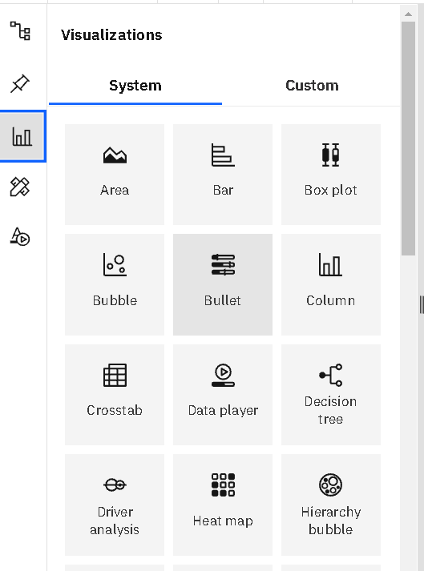
DATA VISUALISATION:
Data visualization is where a given dataset is presented in a graphical format. It helps the detection of patterns, trends and correlations that might go undetected in text-based data.
Using the future loan eligibility loan prediction analytics dataset, we plan to create various graphs and charts to highlight the insights and visualizations.
To visualize the dataset we need IBM Congo's analytics Dashboard .These Dashboard contains Different Visualizations such as Area,Bar,Box plot,Bubble,Column,Dataplayer, Decision tree, Driver analysis,Heatmap,Hierarchy bubble etc.

Slide 7
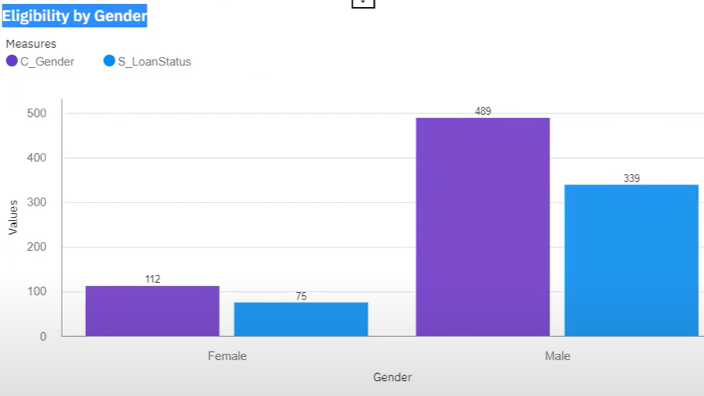
DATA VISUALISATION CHARTS :
Eligibility By Gender
Distribution of Loan Eligibility Status based on Gender.
Here we will analyze the loan eligibility based on gender.

Slide 8
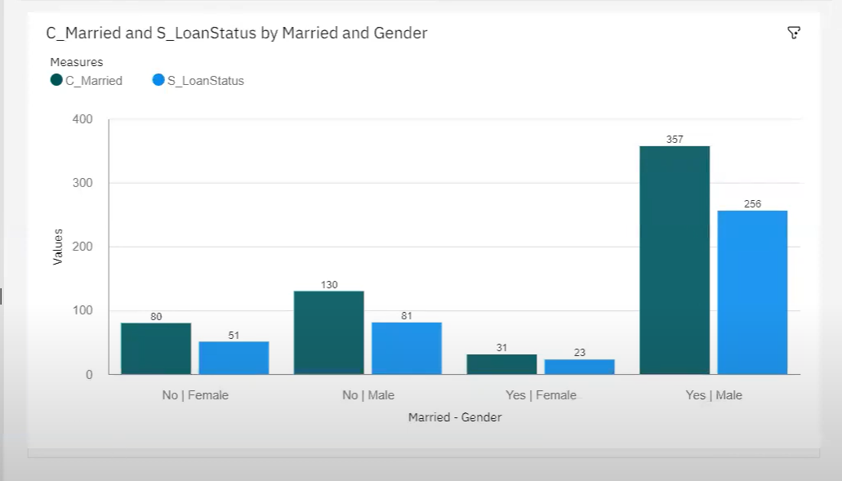
DATA VISUALIZATION CHARTS
Eligibility By Marital Status:
Distribution of Loan Eligibility Status based on Marital Status and Gender.
Here we will analyze the loan eligibility based on marital status and Gender.

Slide 9
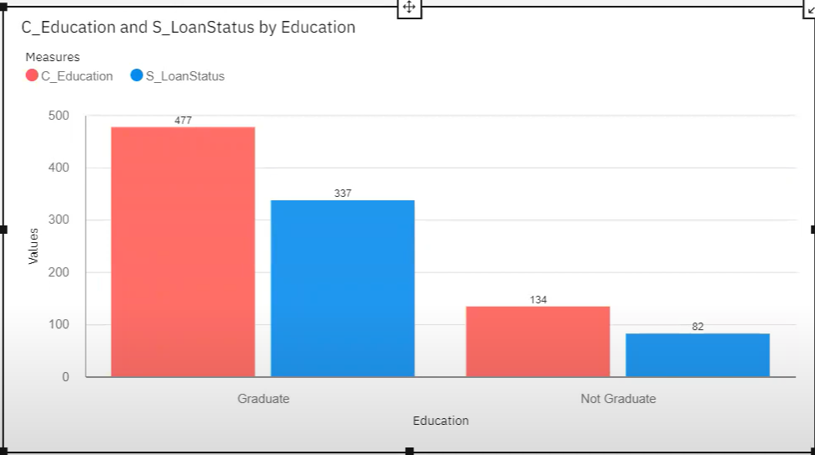
DATA VISUALIZATION CHARTS
Eligibility By Educational Status:
Distribution of Loan Eligibility by Educational Status.

Slide 10
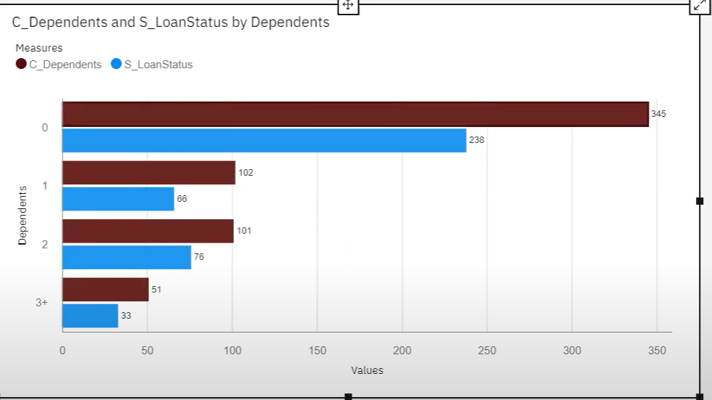
DATA VISUALIZATION CHARTS
Eligibility Based On Dependents
Distribution of Loan Eligibility by Number of Dependents.
Here we will analyze the loan eligibility based on number of dependents.

Slide 11
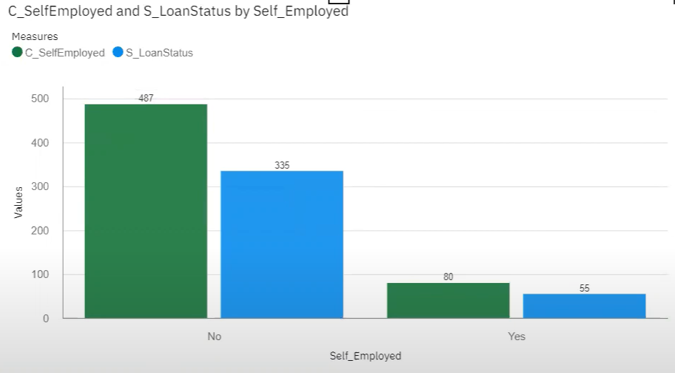
Data visualization charts:
Eligibility Based On Self Employment Status.
Distribution of Loan Eligibility based on Self-Employment status.
Here we will analyze the loan eligibility based on Self Employment Status.

Slide 12
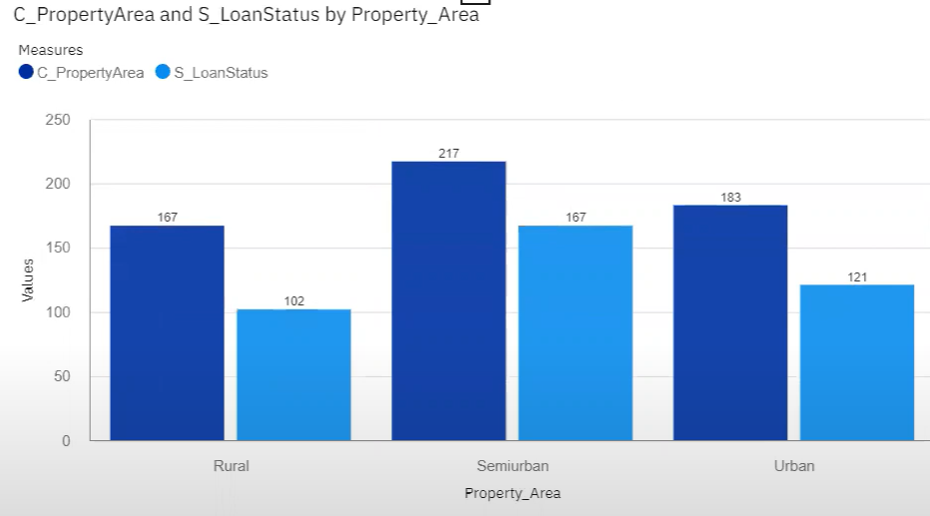
Data visualization charts:
Eligibility Based On Property Area
Distribution of Loan Eligibility based on Property- Area.
Here we will analyze the loan eligibility based on Property Area.

Slide 13
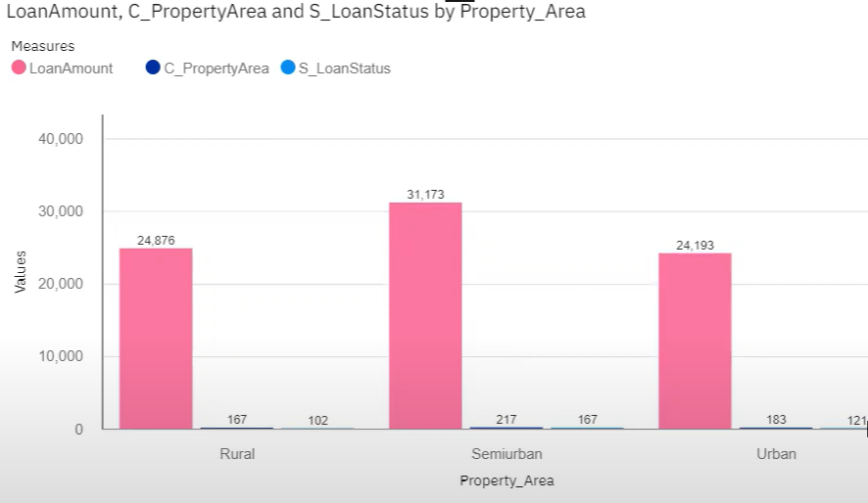
Data visualization charts:
Eligibility Based On Property Area And Loan Amount
Distribution of Loan Eligibility based on Property Area and Loan Amount
Here we will analyze the loan eligibility based on Property Area and Loan Amount.

Slide 14
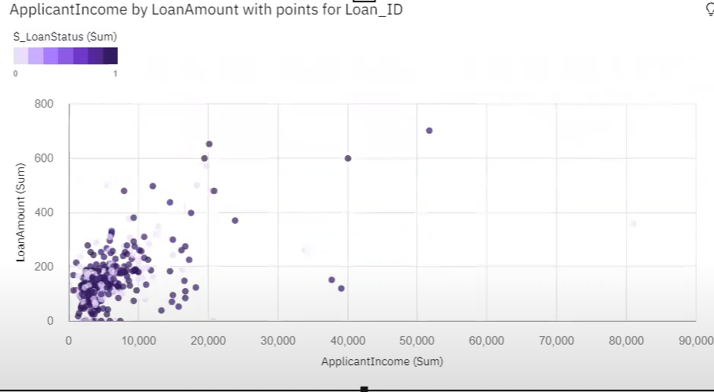
Data visualization charts:
Eligibility Based On Income & Loan Amount
Distribution of Loan Eligibility by Applicant Income by Loan Amount with points for Loan_ ID
Here we will analyze the loan eligibility based on Income & Loan Amount.

Slide 15
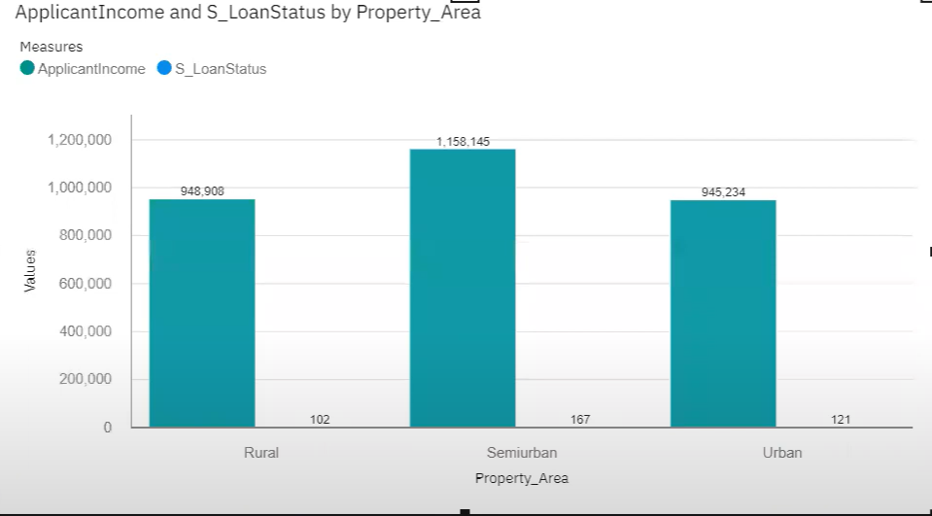
Data visualization charts:
Eligibility Based On Applicant Income & Property_ Area:
Distribution of Loan Eligibility based on Applicant Income & Property_ Area
Here we will analyze the loan eligibility based on Applicant Income & Property Area.

Slide 16
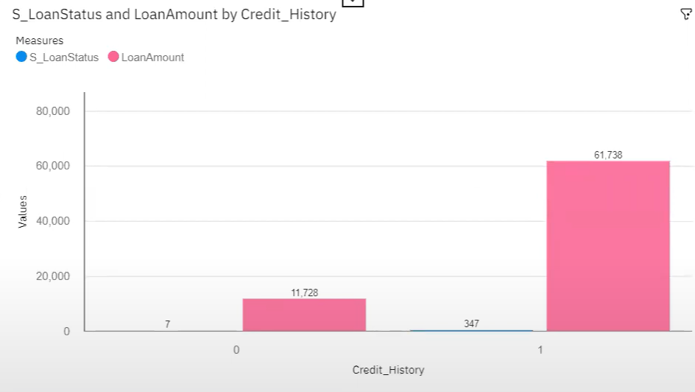
Data visualization charts:
Eligibility Based On Loan Amount & Credit History.
Distribution of Loan Eligibility based on Loan Amount and Credit History.
Here we will analyze the loan eligibility based on Loan Amount & Credit History.

Slide 17
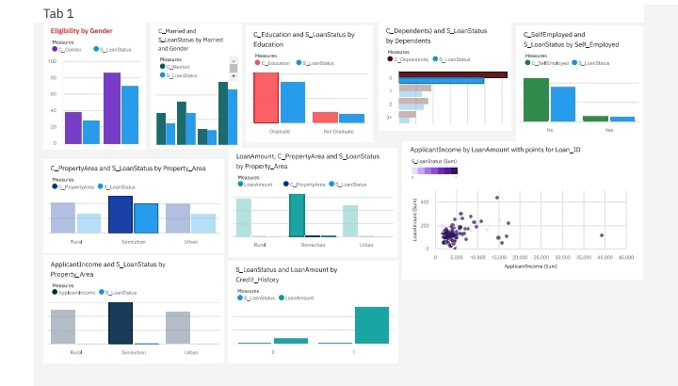
DASHBOARD CREATION:
Once you’ve created views on different tabs in Cognos analytics, you can pull them into a dashboard

Slide 18
SOFTWARE REQUIREMENTS:
IBM Congo's Analytics Dashboard IBM Account Visualization tools: piechart,bars,bubble,bar-graph etc,,

Slide 19
CONCLUSION:
In this project we have presented that we will be analyzing some important visualizations, creating a dashboard and by going through these we will get most of the insights of the future loan eligibility prediction analytics .

